Slide 1
Global power platform bootcamp
24 February 2023, Milan
Enhanced component properties, a new way to work with Component Library
Nicolò Ferranti

Slide 2





Nicolò Ferranti
Consultant Modern Workplace @Avanade Italy
N1C0-95
likendin.com/in/nicolòferranti
nicoloferranti.net
Power Platform certified

Slide 3




MEET THE Sponsors
Agic Technology
Lobra Futura
Mind the Head
Apvee Solutions
agictech.com
lobrafutura.com
mindthehead.it
apvee.com
3

Slide 4

JOIN US AT
EUROPEAN
POWER PLATFORM
CONFERENCE
DUBLIN
20-22 JUNE 2023
Use the code: EPPCMilano

Slide 5

WIN a 2 Day
EUROPEAN
POWER PLATFORM
CONFERENCE
Ticket
Enter today:

Slide 6
Agenda
Why should you be interested in Power Apps Canvas ?
What are custom connector and component library ?
What is enhanced component properties?
Demo
Overview

Slide 7



Why should you be interested in Power Apps canvas?
Reducing IT cost and complexity, increase speed and agility to accommodate various demand without losing IT governance.
Rapid delivery reduce technical skills barriers and agility to change behaviors according to the business needs.
misconception
Data Sources
Extend
Low/no code doesn’t mean “no technical skills”
You can choose from different data sources especially Dataverse.
You can extend the platform:
Using Power Apps Component Framework
Creating custom connector
7

Slide 8




Custom Connector
There are many connectors but yours might be missing. Managing the security and authentication is easy.
Adopting custom connector improve the collaboration between traditional developer and citizen developer.
API
Step up process to work with custom connector :
Custom Connector
Use
Adding it in your app or flow
Share
Allowing user to edit, update, delete, and access (optional)
Test
Test a specified operation of this custom connector
Custom API
Create
Apps or Flow
General information
Security
Definition
8

Slide 9
Pitfalls
Performance
Overusing HTTP
Power Apps’ HTTP request is a crucial aspect for performance.
Execute more than necessary HTTP request. You need to restrict them.
Duplicate information
Component library
You are asking for an information that you already have.
Incorrect use of a component can lead to problems and compromise ongoing deployment and management.
9

Slide 10
Component library
Using Component Library is the best way to archive components in one position and is strongly suggested when you work with a huge power apps canvas.
Component allows you to create custom controller which may be used in one or more apps. You can define input and output property for your component.
API
GET List Product
Custom Connector
Custom Connector
OnReset property
store
Product 1
Product 2
Product 3
Product N
Input property
PUT Product
callback
price €
price €
price €
price €
20% off
20% off
20% off
20% off
Main App
Event
Component
10

Slide 11
Enanched component Property
You can fire a custom event from the component to the main app using behavior property. Also, you can pass parameters for a property evaluation.
Previously, you could get the same result using Toggle control or OnReset property.
Both of them were complicated to manage.
Why is it useful ?
Optimize connector’s request
Exchange of information between the component and main app is easier
Data centralization
Develop better components
11

Slide 12
Demo
12

Slide 13

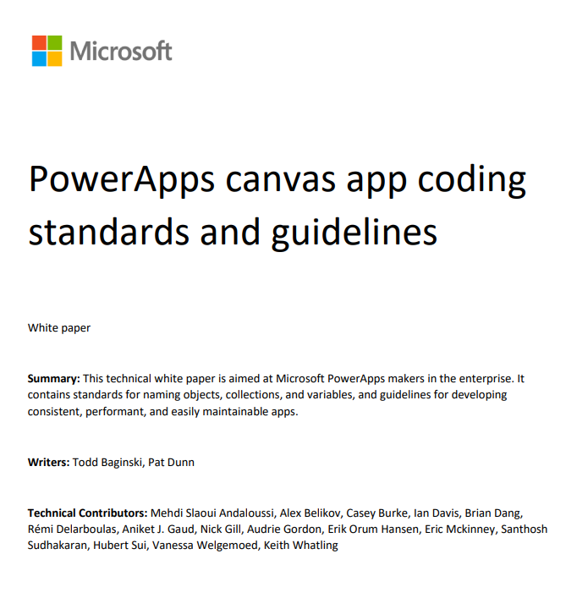

Thank you
Resources:
powerapps.microsoft.com/en-us/blog/enhanced-component-properties/
Mastering Minimal APIs in ASP.NET Core: Build, test, and prototype web APIs quickly using .NET and C# - Andrea Tosato, Marco Minerva, Emanuele Bartolesi
pahandsonlab.blob.core.windows.net/documents/PowerApps%20canvas%20app%20coding%20standards%20and%20guidelines.pdf
nicoloferranti.net/enhanced-component-properties/
13

Slide 14
Any Questions?

Slide 15

Please fill out the survey!
https://aka.ms/gppb23mifeedback

